Slide 1
Using supervised learning algorithms to model the behavior of Road Weather Information System sensors
Tobias Axelsson

Slide 2
Agenda

Slide 3

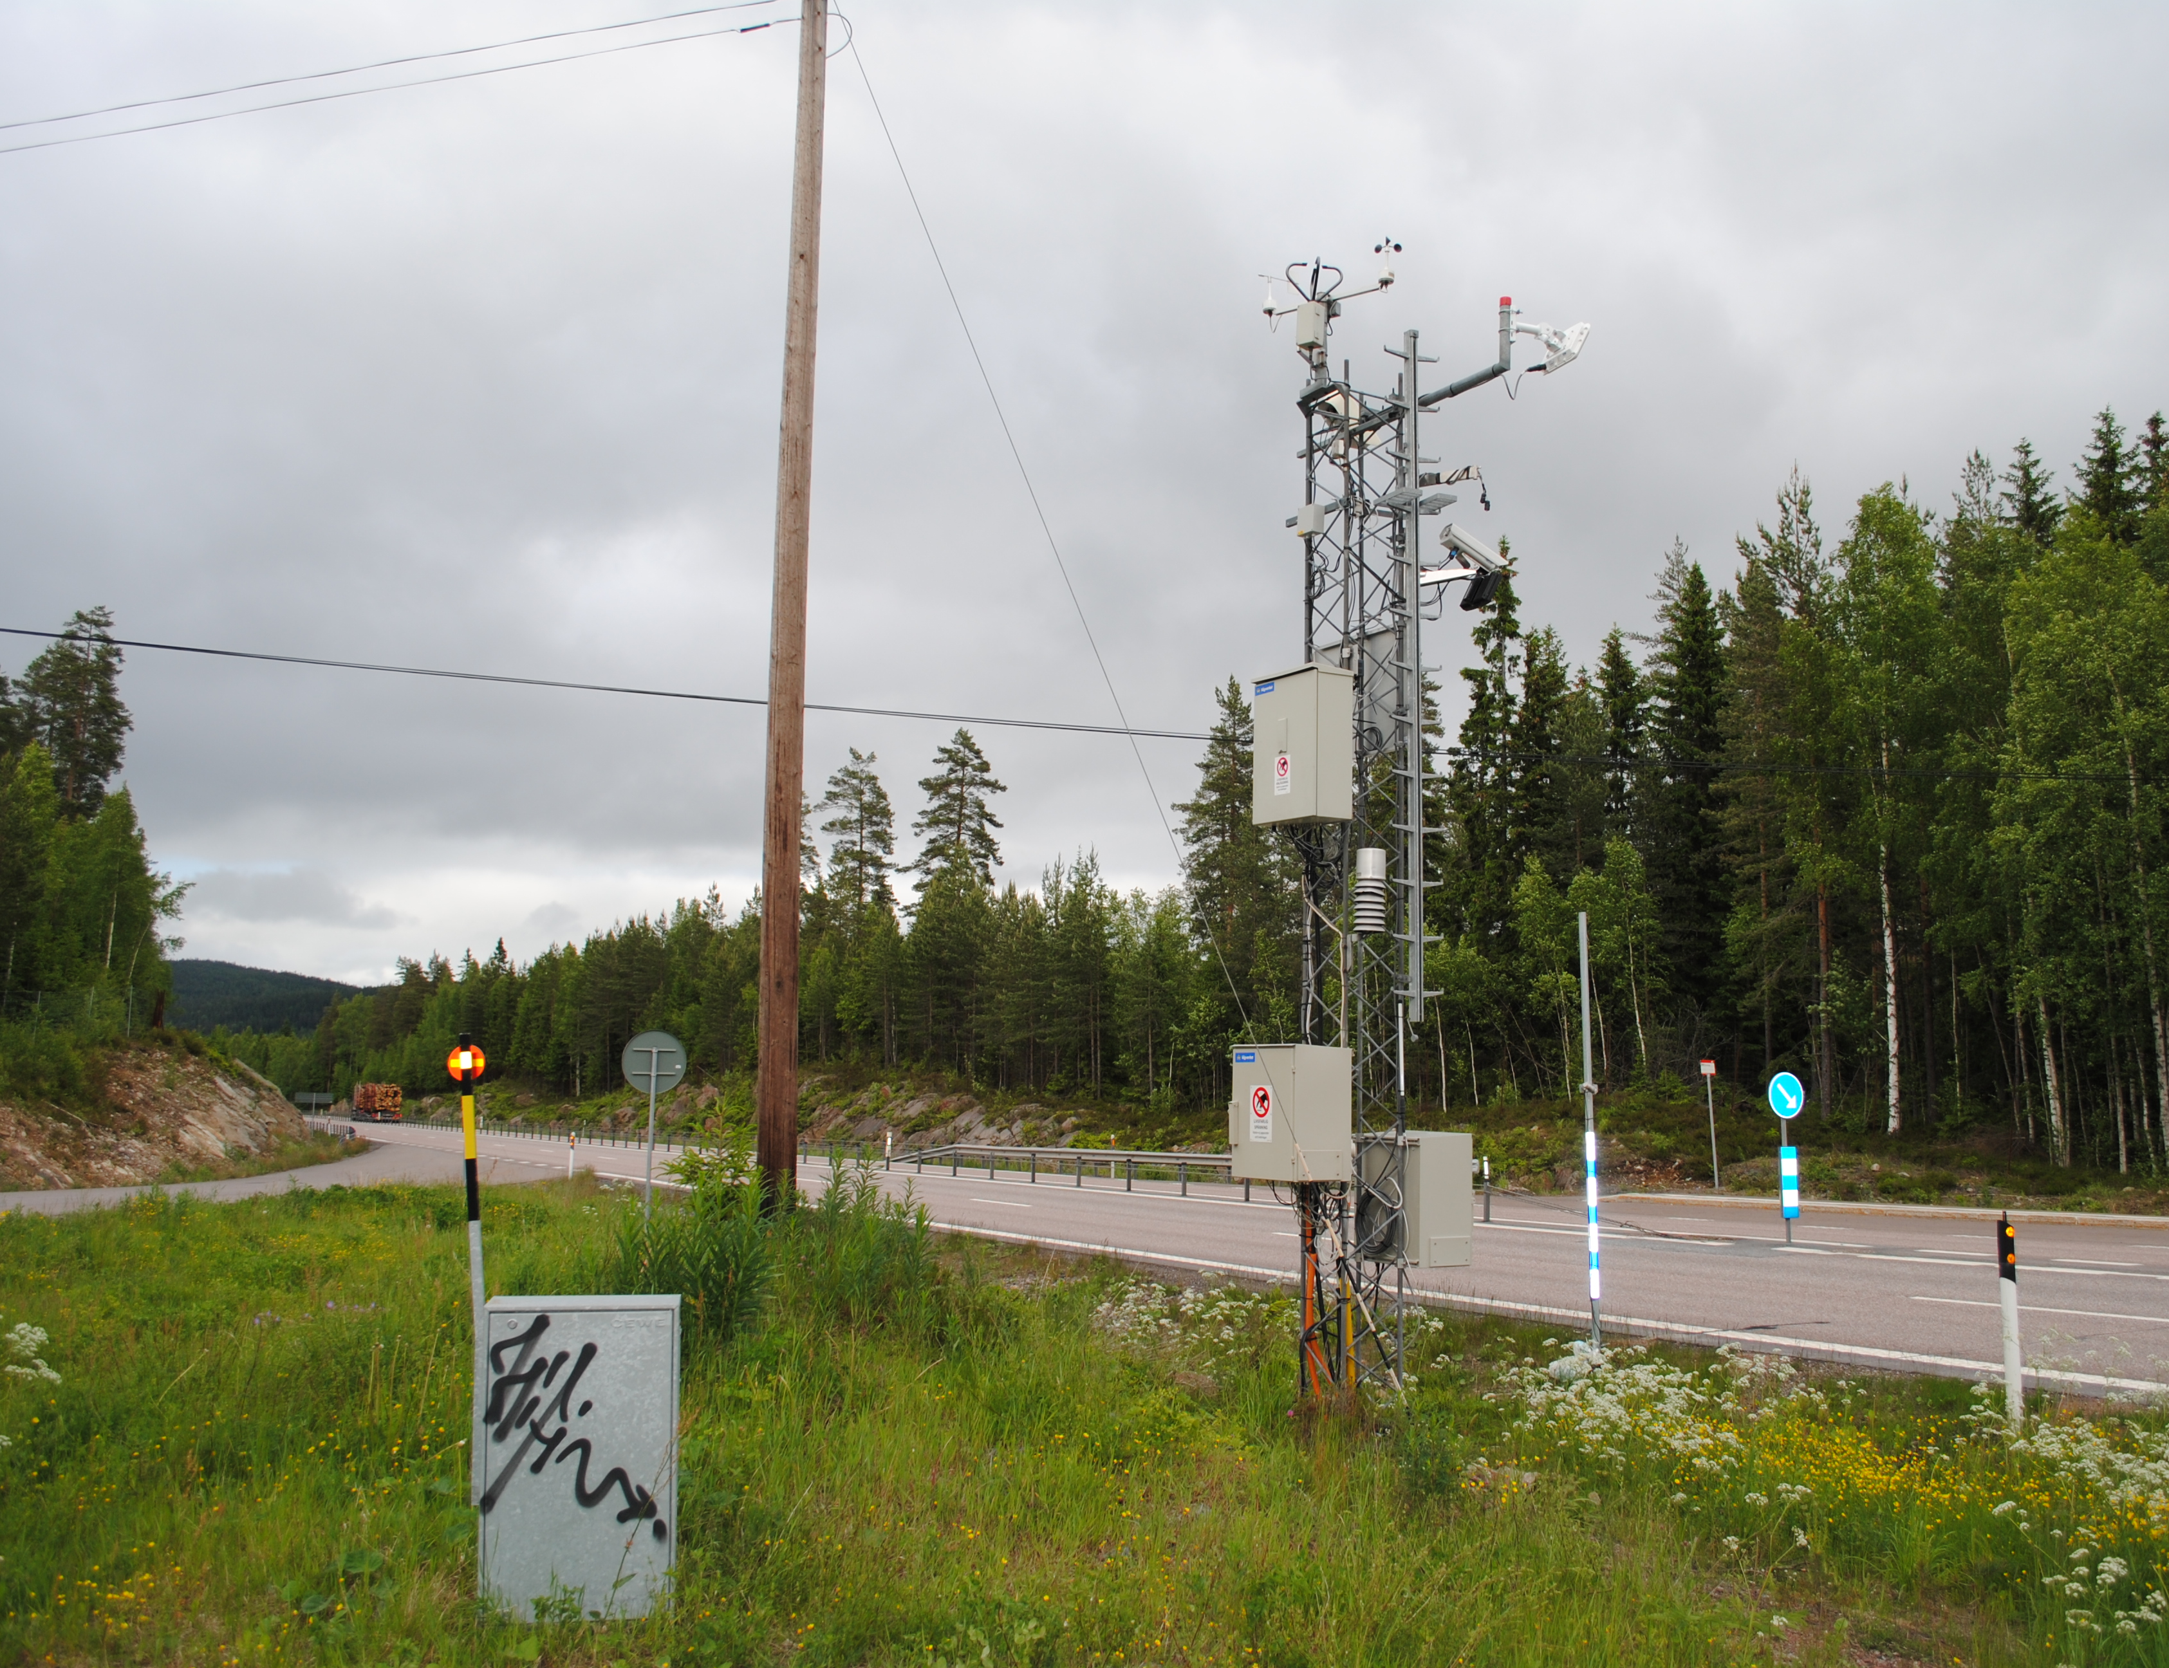
Road Weather Information System (RWIS)
Owned by Trafikverket
Used primarily for winter road maintenance work
~ 800 RWIS in Sweden
Measure every 30 minutes
Wind speed
Wind direction
Road surface temperature
Road friction
And more…

Slide 4
Road Weather Information System (RWIS)
Sensor/instrument name | Measures | Value | N.o. stations
Optic Eye | Precipitation type | Discrete | All
Optic Eye | Precipitation amount | Continuous | All
Track Ice Road Sensor (TIRS) | Road surface temperature | Continuous | All
DST111 | Road surface temperature | Continuous | ~ 7
DSC111 | Road surface condition | Discrete | ~ 26
DSC111 | Road friction | Continuous | ~ 26
MS4 | Timestamp | Date (mmddhhmm) | All

Slide 5
Problems/challenges RWIS
MS4 generation shift
TIRS is dug down into the road
Sensors fail
DSC111 ~ 31% of the time
Can sensors be replaced by software?

Slide 6

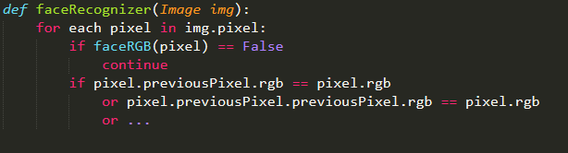
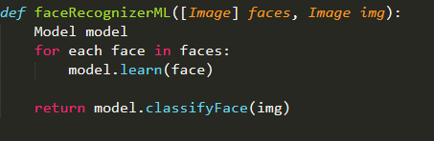
Machine learning
Example: Software to recognize faces
?
”Manually”
https://opengameart.org/sites/default/files/trump%20pixel%20grande.png
Machine learning

Slide 7


Supervised learning
Goal: Build a model (input -> output)
Train/test on a dataset
Ex: Holdout
”Teacher” gives the right answers
Classification: Place observations into classes
Ex. Gmail spam/not spam
Regression: Predict a quantity
Ex. Predict wind speed $w_{s}$ from time $t$ and wind direction $w_{d}$ using OLS $w_{s}=β_{0}+β_{1}w_{d}+β_{2}t=4+0.2w_{d}+1.7t$
https://encrypted-tbn0.gstatic.com/images?q=tbn:ANd9GcTz7gegFXeEYowCV8bklRTQaCcRBcLVcc19yFidynarB599VL12Sg

Slide 8


Performance evaluation
Generalization
Underfitting
Overfitting
Evaluate classifyer
Accuracy = $\frac{n.o. correct classifications}{total}$
Recall
Precision
F1
Evaluate regressor
Mean Squared Error (MSE)
https://3gp10c1vpy442j63me73gy3s-wpengine.netdna-ssl.com/wp-content/uploads/2018/03/Screen-Shot-2018-03-22-at-11.22.15-AM.png

Slide 9
Thesis objective
Thesis objective: Model Optic Eye, TIRS, DST111 sensors
Subtasks
Best supervised algorithm to classify precipitation type using
Timestamp
DST111 road surface temperature
Road friction
Road surface condition
Best supervised algorithm to predict precipitation amount using
Timestamp
DST111 road surface temperature
Road friction
Road surface condition

Slide 10
Thesis objective
Subtasks
-
-
Best supervised algorithm to predict TIRS road surface temperature using
Timestamp
Precipitation type
Precipitation amount
DST111 road surface temperature
Road friction
Road surface friction
Best supervised algorithm to predict DST111 road surface temperature using
Timestamp
Precipitation type
Precipitation amount
Road friction
Road surface condition

Slide 11
Delimitations
Many algorithms.. Qualified if:
Supervised learning
Available Scikit-learn
Belongs to one of following algorithm families
Decision tree based learning
Instance based learning
Bayesian learning
Regression based learning
Artificial Neural Networks
Ensemble learning
Model non-error behavior only
Hyperparameter optimization:
K in kNN
N.o. hidden nodes in MLP
λ in Lasso

Slide 12
Provided data
171425 measurements (observations)
2015-2016 state road E6, Sweden
Snapshot:
Features
Timestamp | SurfTemp-TIRS | PrecType-OE | PrecAmount-OE | SurfTemp-DST111 | Friction-DSC111 | SurfCond-DSC111
1010000 | 4 | 1 | 0 | 3.9 | 0.8 | 0
1010030 | 3.9 | 1 | 0 | 3.7 | 0.8 | 0
1010100 | 3.9 | 1 | 0 | 3.9 | 0.8 | 0
1010130 | 3.9 | 1 | 0 | 3.8 | 0.8 | 0
1010200 | 3.9 | 1 | 0 | 3.8 | 0.8 | 0
1010230 | 3.9 | 1 | 0 | 4 | 0.8 | 0
1010300 | 3.9 | 1 | 0 | 3.9 | 0.8 | 0
1010330 | 3.9 | 1 | 0 | 3.9 | 0.8 | 0

Slide 13
Research approach
Choose algorithms to evaluate
”Spot-checking” experiments, optimal choice of:
Input features
Hyperparameter settings
Tools:
Python
Scikit-learn
…

Slide 14
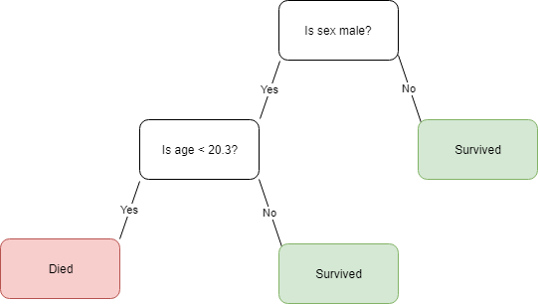

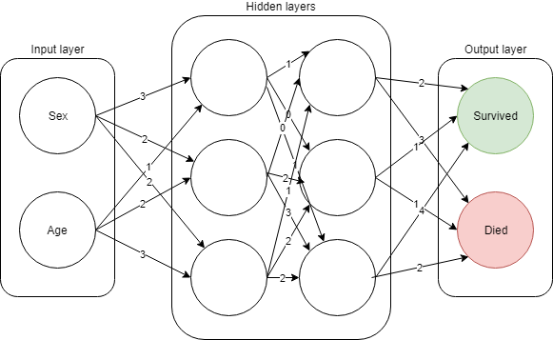
Supervised learning algorithms
Decision tree based learning
CART
Instance based learning
kNN
Bayesian learning
Naïve bayes
Regression based learning
OLS
Logistic regression
Artificial Neural Networks
Multi-layer perceptron (MLP)
Ensemble learning
Random forest
Regularization*
Lasso
https://upload.wikimedia.org/wikipedia/commons/thumb/e/e7/KnnClassification.svg/220px-KnnClassification.svg.png

Slide 15

Experimental methodology
Data preparation
Data cleaning
Feature selection
Data transformation
Obtaining the results
Rank input features to target feature $f_{t}$
Find best choice of top features for $f_{t}$
Optimize hyperparameters
Highest $P_{acc}=P_{test}+/−overfitting=$best algorithm to model $f_{t}$

Slide 16
Data preparation process – data cleaning
Delimitations: non-error behavior only
Remove suspicious outliers
Remove definitive errors
56245 observations removed => 115180 remained

Slide 17
Data preparation process – feature selection
Timestamp (mmddhhmm)
Large numeric interval
Experiment: predict TIRS road surface temperature
Algorithm | MSE not using timestamp | MSE using timestamp
OLS | 1.23 | 1.22
CART | 1.21 | 1.84
kNN | 1.25 | 4.69
MLP | 1.06 | 55663.45
Lasso | 1.25 | 1.24
Random forest | 1.13 | 1.26
Average total | 1.19 | 9279.13

Slide 18
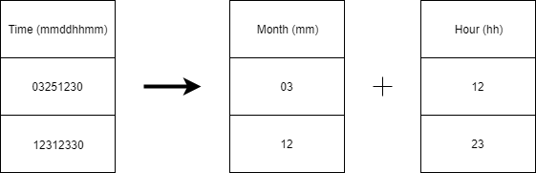
Data preparation process – Data transformation
Transform timestamp to two new features:
Month
Hour
Experiment:
Algorithm | MSE not using any time features | MSE timestamp | MSE hour and month | MSE month | MSE hour
OLS | 1.23 | 1.22 | 1.22 | 1.22 | 1.21
CART | 1.21 | 1.84 | 1.77 | 1.34 | 1.39
kNN | 1.25 | 4.69 | 1.08 | 1.24 | 1.15
MLP | 1.06 | 55663.45 | 1.30 | 1.06 | 1.08
Lasso | 1.25 | 1.24 | 1.23 | 1.24 | 1.23
Random forest | 1.13 | 1.26 | 1.01 | 1.02 | 1.12
Average total | 1.19 | 9279.13 | 1.27 | 1.19 | 1.20

Slide 19
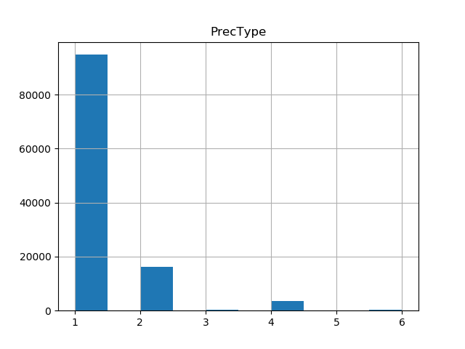
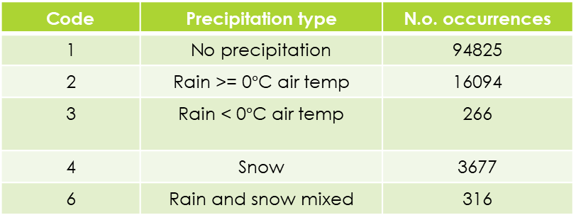
Supervised learning algorithms
Deal with class imbalance: precipitation type
Oversampling
Smote
Adasyn
Random oversampling
Unsuccessfully..
Code | Precipitation type | N.o. occurrences
1 | No precipitation | 94825
2 | Rain >= 0$°$C air temp | 16094
3 | Rain < 0$°$C air temp | 266
4 | Snow | 3677
6 | Rain and snow mixed | 316

Slide 20
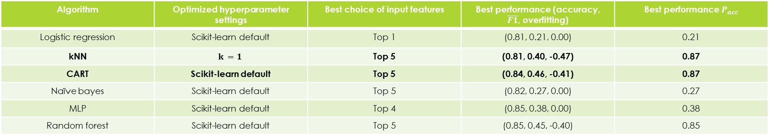
Results – classify precipitation type
Input feature relevancy ranking | Input feature | Correlation score
1 | Road surface condition | 4506.14
2 | Road friction | 4274.88
3 | DST111 road surface temperature | 1263.89
4 | Hour | 609.45
5 | Month | 16.71
Find optimized choice of top relevant input features for each algorithm
Optimize hyperparameters
Algorithm | Optimized hyperparameter settings | Best choice of input features | Best performance (accuracy, $\overline{F1}$, overfitting) | Best performance $P_{acc}$
Logistic regression | Scikit-learn default | Top 1 | (0.81, 0.21, 0.00) | 0.21
kNN | $$k =1$$ | Top 5 | (0.81, 0.40, -0.47) | 0.87
CART | Scikit-learn default | Top 5 | (0.84, 0.46, -0.41) | 0.87
Naïve bayes | Scikit-learn default | Top 5 | (0.82, 0.27, 0.00) | 0.27
MLP | Scikit-learn default | Top 4 | (0.85, 0.38, 0.00) | 0.38
Random forest | Scikit-learn default | Top 5 | (0.85, 0.45, -0.40) | 0.85

Slide 21

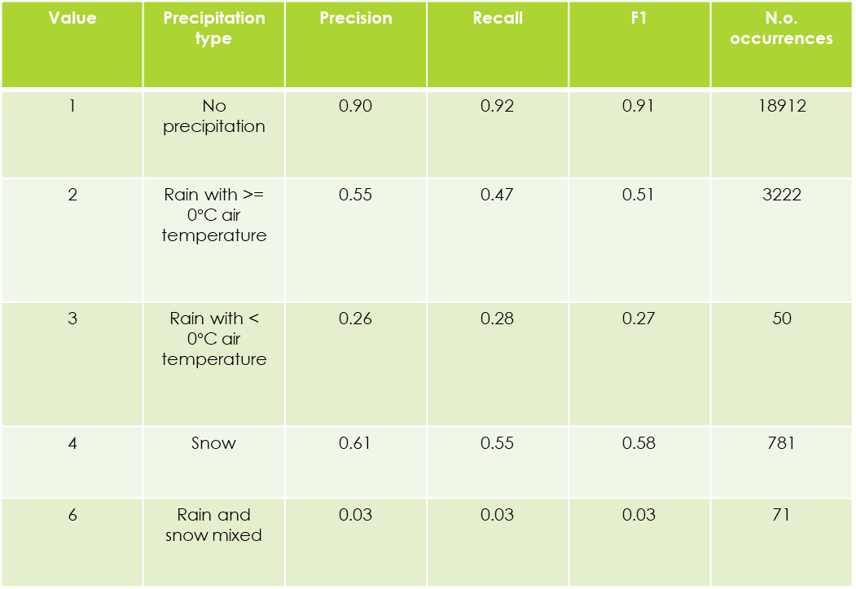
Results – classify precipitation type
Value | Precipitation type | Precision | Recall | F1 | N.o. occurrences
1 | No precipitation | 0.90 | 0.92 | 0.91 | 18912
2 | Rain with >= 0$°$C air temperature | 0.55 | 0.47 | 0.51 | 3222
3 | Rain with < 0$°$C air temperature | 0.26 | 0.28 | 0.27 | 50
4 | Snow | 0.61 | 0.55 | 0.58 | 781
6 | Rain and snow mixed | 0.03 | 0.03 | 0.03 | 71
Winner: CART
Accuracy = 0.84
$\overline{F1}$= 0.46
Settings: Scikit-learn default
Input features:
DST111 road surface temperature
road surface condition
road friction
month
hour

Slide 22
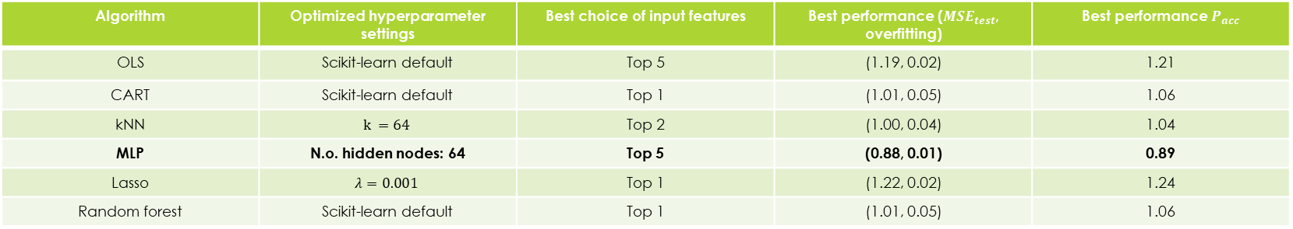
Results – predict TIRS road surface temperature
Input feature relevancy ranking | Input feature | Correlation score
1 | DST111 road surface temperature | 7688772.49
2 | Road surface condition | 11048.87
3 | Road friction | 6840.20
4 | Month | 4300.00
5 | Hour | 1968.02
6 | Precipitation type | 1784.49
7 | Precipitation amount | 238.91
Find optimized choice of top relevant input features for each algorithm
Optimize hyperparameters
Algorithm | Optimized hyperparameter settings | Best choice of input features | Best performance (${MSE}_{test}$, overfitting) | Best performance $P_{acc}$
OLS | Scikit-learn default | Top 5 | (1.19, 0.02) | 1.21
CART | Scikit-learn default | Top 1 | (1.01, 0.05) | 1.06
kNN | $$k =64$$ | Top 2 | (1.00, 0.04) | 1.04
MLP | N.o. hidden nodes: 64 | Top 5 | (0.88, 0.01) | 0.89
Lasso | $$λ=0.001$$ | Top 1 | (1.22, 0.02) | 1.24
Random forest | Scikit-learn default | Top 1 | (1.01, 0.05) | 1.06

Slide 23
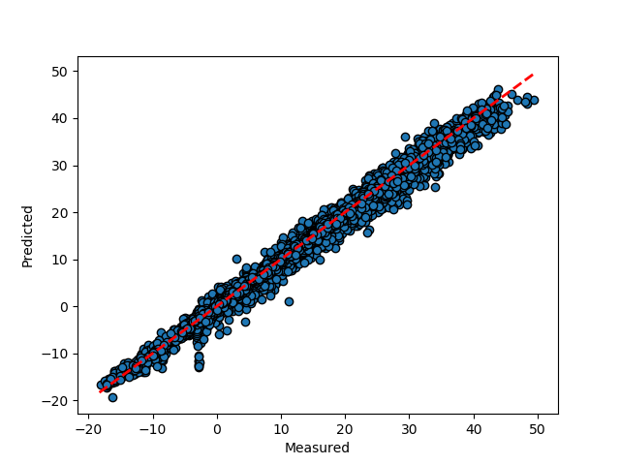
Results – predict TIRS road surface temperature
Winner: MLP
MSE = 0.89
Settings: 64 hidden nodes
Input features:
DST111 road surface temperature
road surface condition
road friction
month
hour
precipitation type

Slide 24
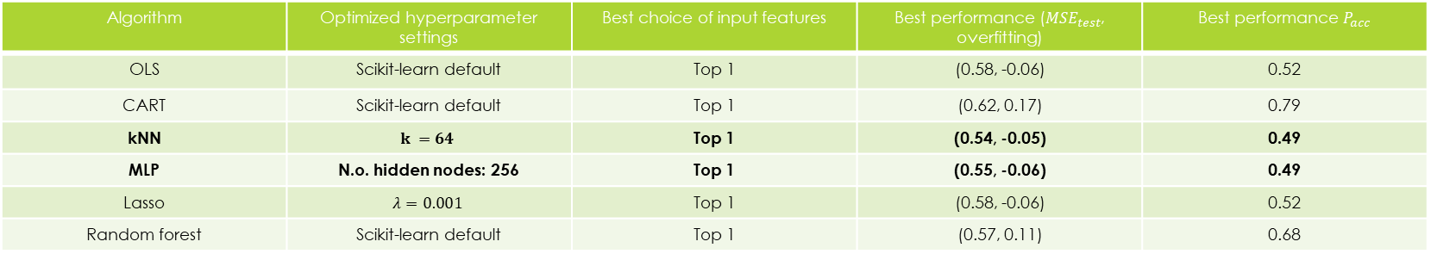
Results – predict precipitation amount
Input feature relevancy ranking | Input feature | Correlation score
1 | Road friction | 4478.75
2 | Road surface condition | 2793.48
3 | DST111 road surface temperature | 234.64
4 | Month | 60.36
5 | Hour | 19.93
Find optimized choice of top relevant input features for each algorithm
Optimize hyperparameters
Algorithm | Optimized hyperparameter settings | Best choice of input features | Best performance (${MSE}_{test}$, overfitting) | Best performance $P_{acc}$
OLS | Scikit-learn default | Top 1 | (0.58, -0.06) | 0.52
CART | Scikit-learn default | Top 1 | (0.62, 0.17) | 0.79
kNN | $$k =64$$ | Top 1 | (0.54, -0.05) | 0.49
MLP | N.o. hidden nodes: 256 | Top 1 | (0.55, -0.06) | 0.49
Lasso | $$λ=0.001$$ | Top 1 | (0.58, -0.06) | 0.52
Random forest | Scikit-learn default | Top 1 | (0.57, 0.11) | 0.68

Slide 25
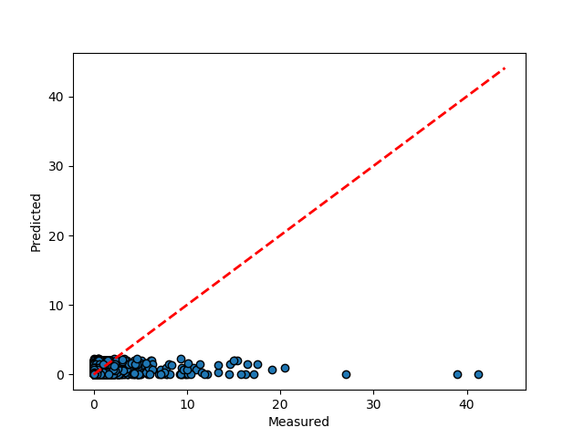

Results – predict precipitation amount
Winner: kNN
MSE = 0.54
Settings: $k=64$
Input feature:
road friction

Slide 26
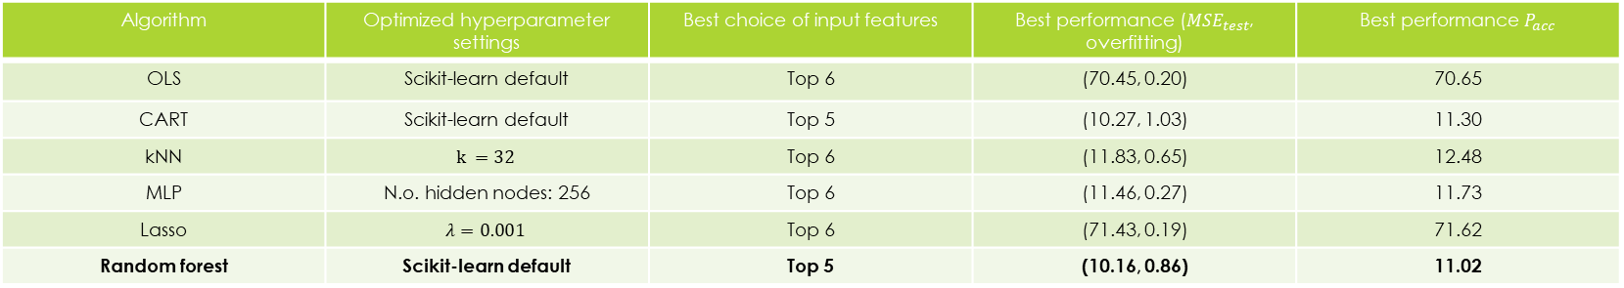
Results – predict DST111 road surface temperature
Input feature relevancy ranking | Input feature | Correlation score
1 | Road surface condition | 11636.00
2 | Road friction | 7411.80
3 | Month | 4990.95
4 | Precipitation type | 1897.37
5 | Hour | 1784.49
6 | Precipitation amount | 234.64
Find optimized choice of top relevant input features for each algorithm
Optimize hyperparameters
Algorithm | Optimized hyperparameter settings | Best choice of input features | Best performance (${MSE}_{test}$, overfitting) | Best performance $P_{acc}$
OLS | Scikit-learn default | Top 6 | (70.45, 0.20) | 70.65
CART | Scikit-learn default | Top 5 | (10.27, 1.03) | 11.30
kNN | $$k =32$$ | Top 6 | (11.83, 0.65) | 12.48
MLP | N.o. hidden nodes: 256 | Top 6 | (11.46, 0.27) | 11.73
Lasso | $$λ=0.001$$ | Top 6 | (71.43, 0.19) | 71.62
Random forest | Scikit-learn default | Top 5 | (10.16, 0.86) | 11.02

Slide 27
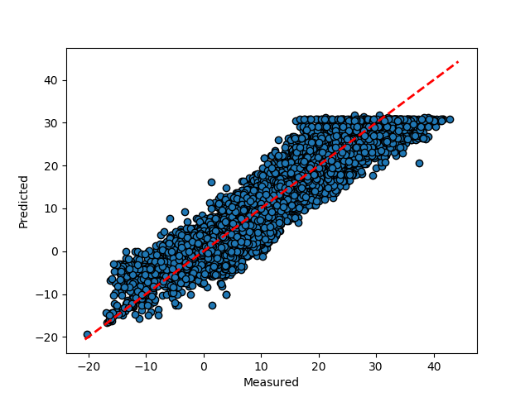
Results – predict DST111 road surface temperature
Winner: Random forest
MSE = 10.16
Settings: Scikit-learn default
Input features:
road surface condition
road friction
Month
hour
precipitation type

Slide 28

Discussion
Good enough?
TIRS road surface temp: MSE = 0.89
DST111 road surface temp: MSE=10.16
Optic Eye precipitation amount: MSE = 0.54
Optic Eye Precipitation type: accuracy = 0.84, $\overline{F1}$ = 0.46
$P_{acc}$ and overfitting
Input feature ranking
Test dataset completely unseen?

Slide 29
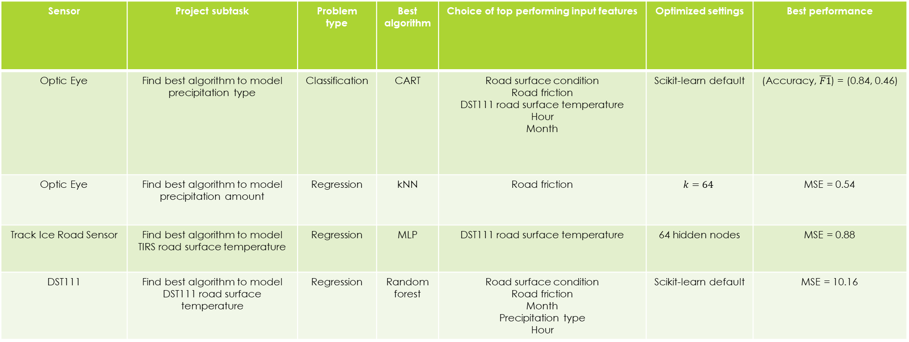
Conclusions - optimized algorithms
Sensor | Project subtask | Problem type | Best algorithm | Choice of top performing input features | Optimized settings | Best performance
Optic Eye | Find best algorithm to model precipitation type | Classification | CART | Road surface condition Road friction DST111 road surface temperature Hour Month | Scikit-learn default | (Accuracy, $\overline{F1}$) = (0.84, 0.46)
Optic Eye | Find best algorithm to model precipitation amount | Regression | kNN | Road friction | $$k=64$$ | MSE = 0.54
Track Ice Road Sensor | Find best algorithm to model TIRS road surface temperature | Regression | MLP | DST111 road surface temperature | 64 hidden nodes | MSE = 0.88
DST111 | Find best algorithm to model DST111 road surface temperature | Regression | Random forest | Road surface condition Road friction Month Precipitation type Hour | Scikit-learn default | MSE = 10.16

Slide 30
Conclusions - continued
Refrain from using negative overfitting scores
Improve algorithm performances by:
Handle class imbalance
Try all combinations of input features

Slide 31
Thank you!

